Slide 1
Opennebula Vs openStack

Slide 2
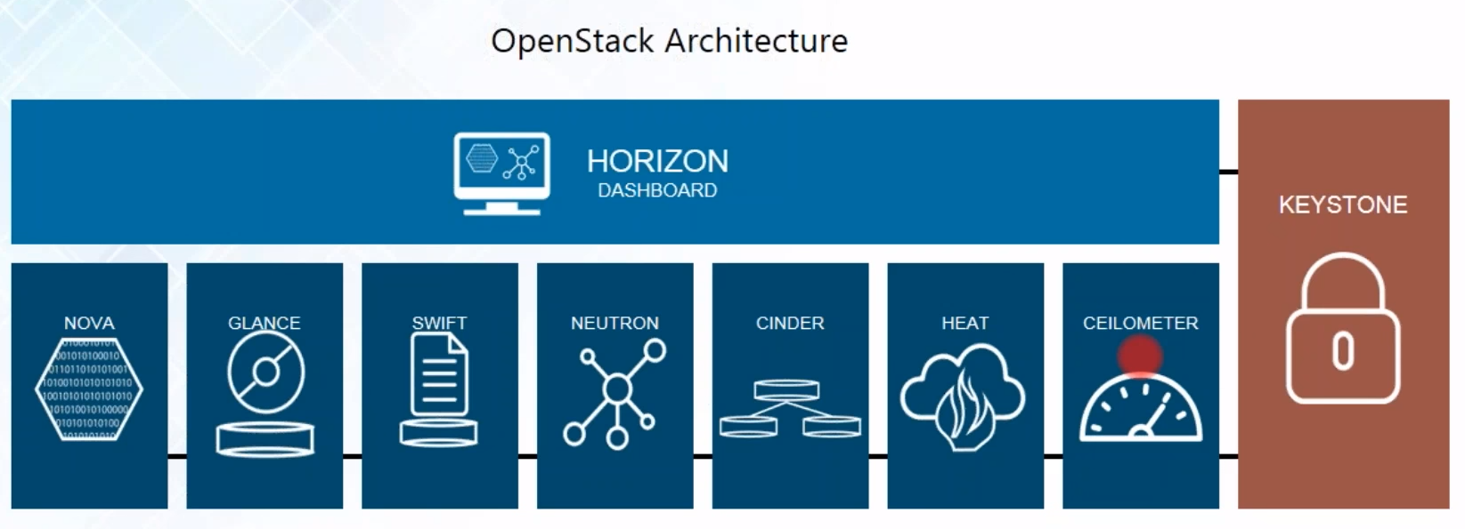
Openstack

Slide 3
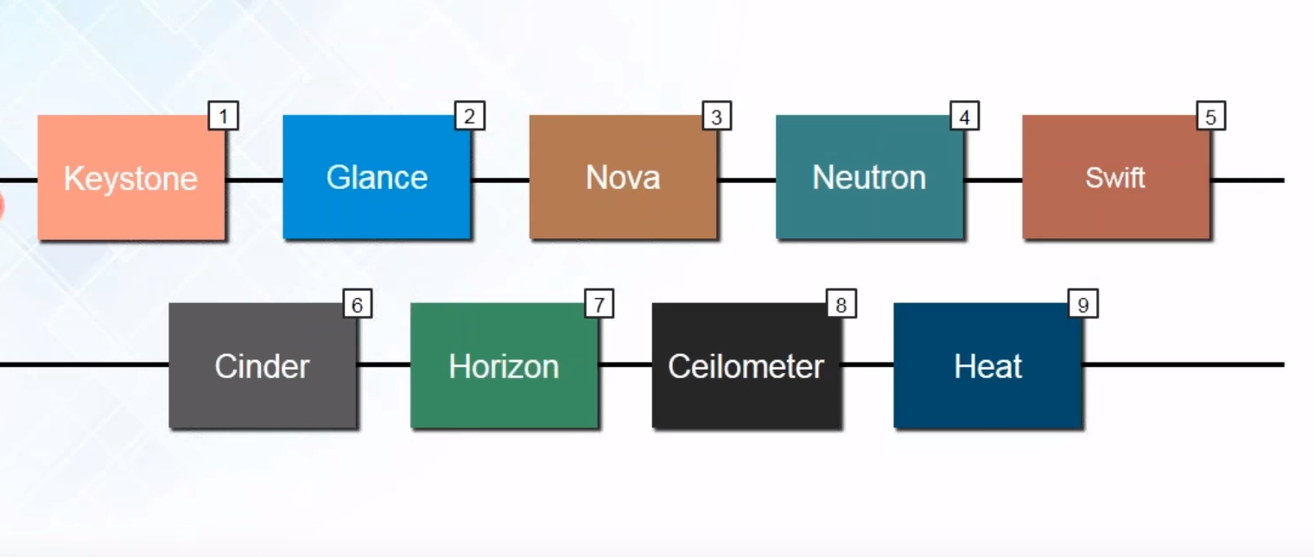
Components

Slide 4
Pros-cons (openstack)
Pros:
Stable version available for each stack
More developer working as compare to other cloud software (solutions)
Made for vender by vender
Cons:
Made for vender by vender, not user centric
Hard to implement
Complex architecture
OpenNebula provides the functionality offered by Openstack Nova, Glance, Horizon, Neutron, Heat, Ceilometer and Keystone, within a single integrated enterprise-ready package

Slide 5

Opennebula
We are choosing this!

Slide 6
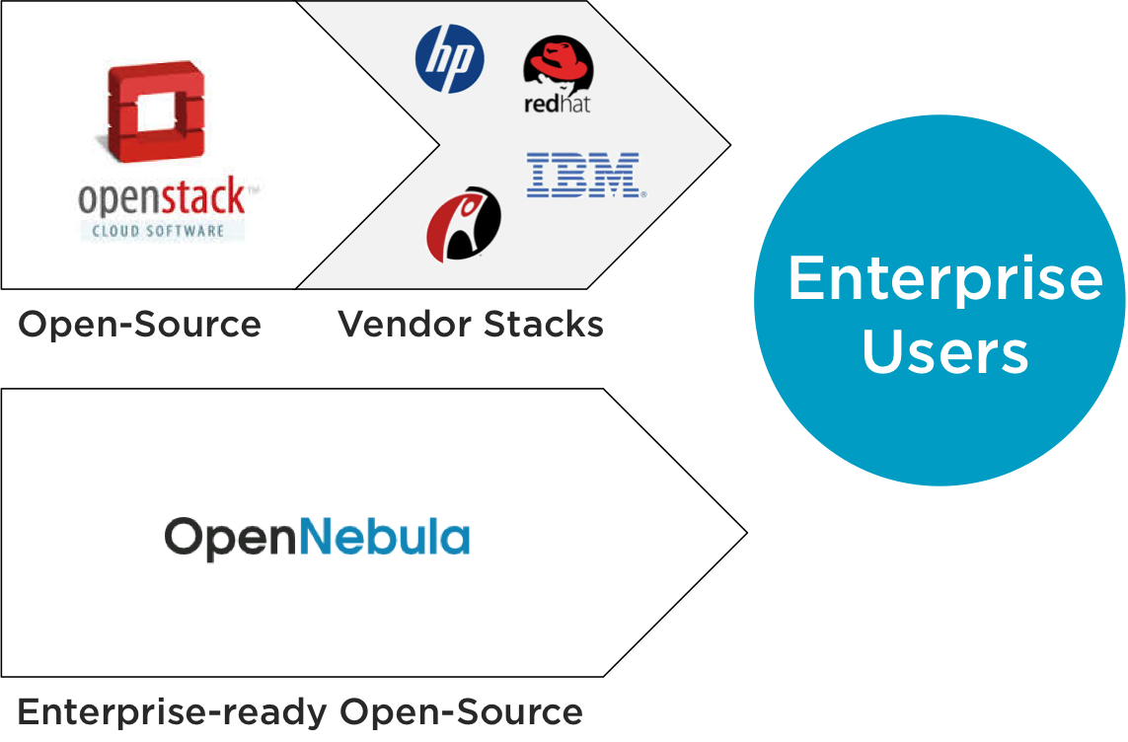
OpenStack comprises many subprojects with different levels maturity
Making even more difficult their integration

Slide 7
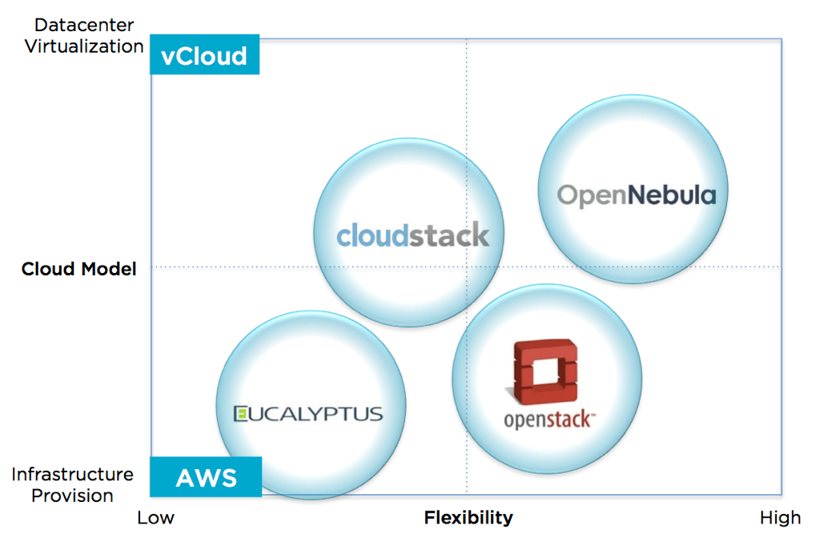

Slide 8
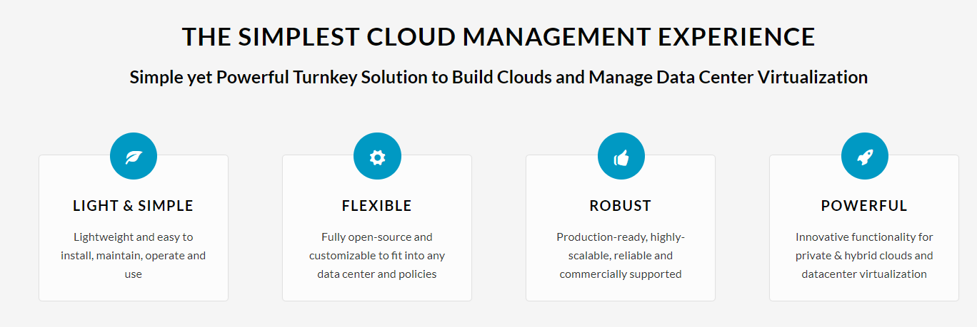
OpenNebula is an open-source effort focused on user needs

Slide 9
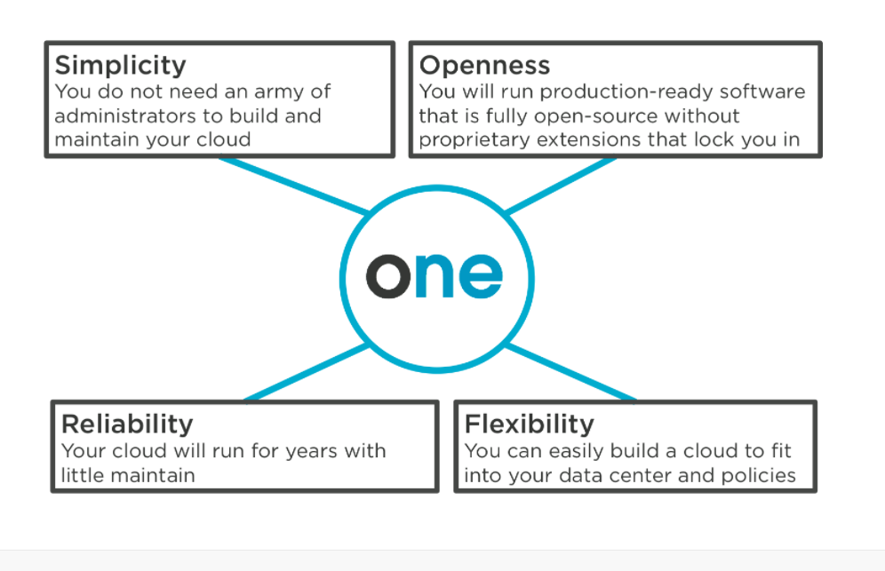

Slide 10
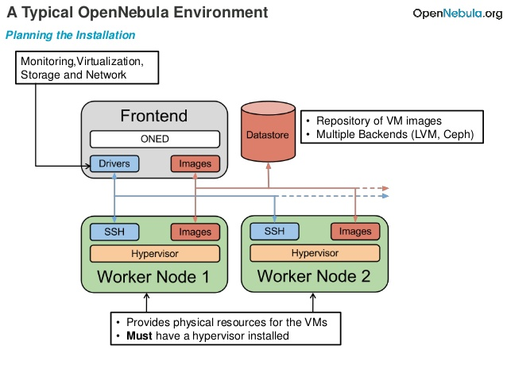

Slide 11
H/w Requirements
1GB free RAM for the Virtual Machine
10 GB of free disk space
A 64-bit kernel
Virtualization Extensions

Slide 12
Download the Virtual Appliance
Download the OVA
Image file having Linux OS
Virtual Box

Slide 13
Installation

Slide 14
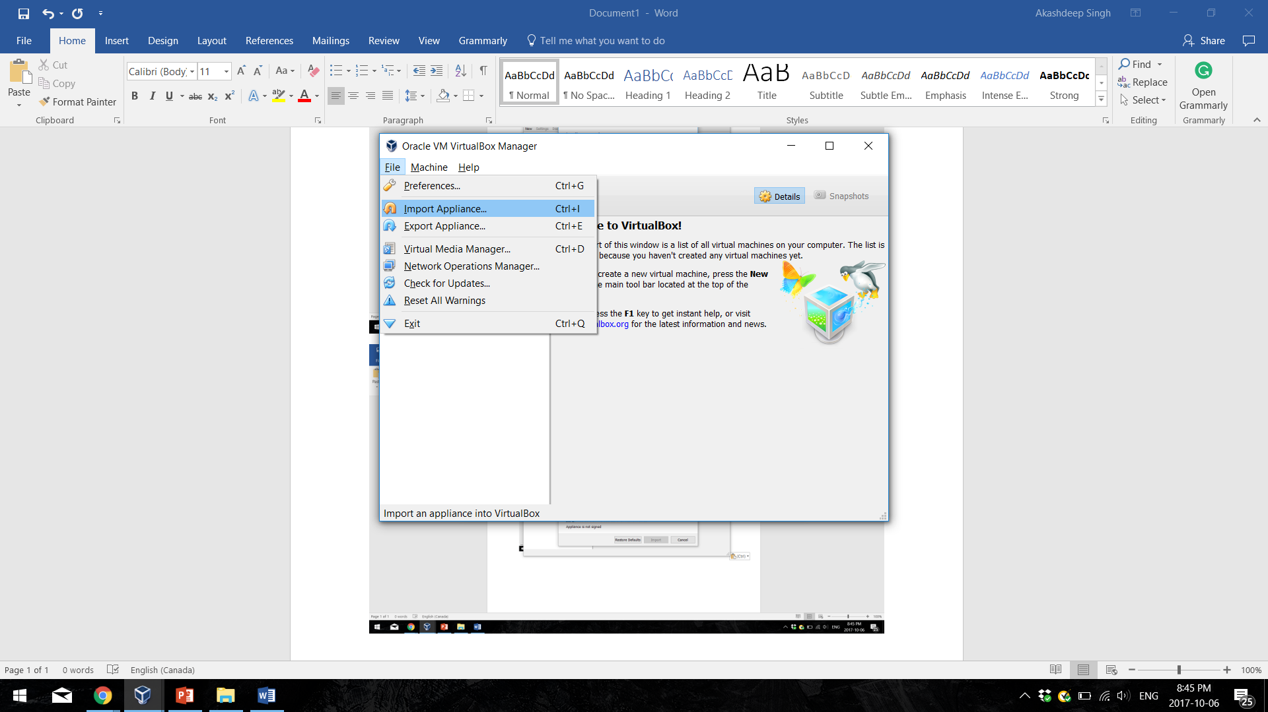

Slide 15
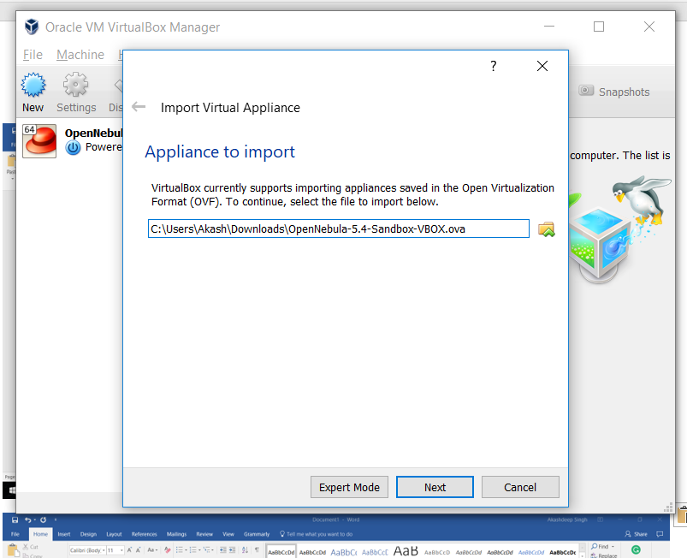

Slide 16
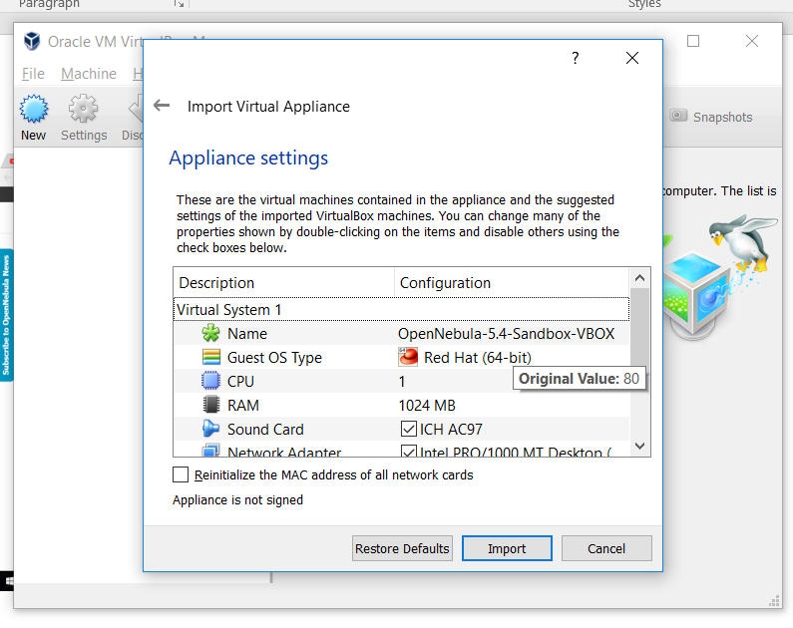

Slide 17
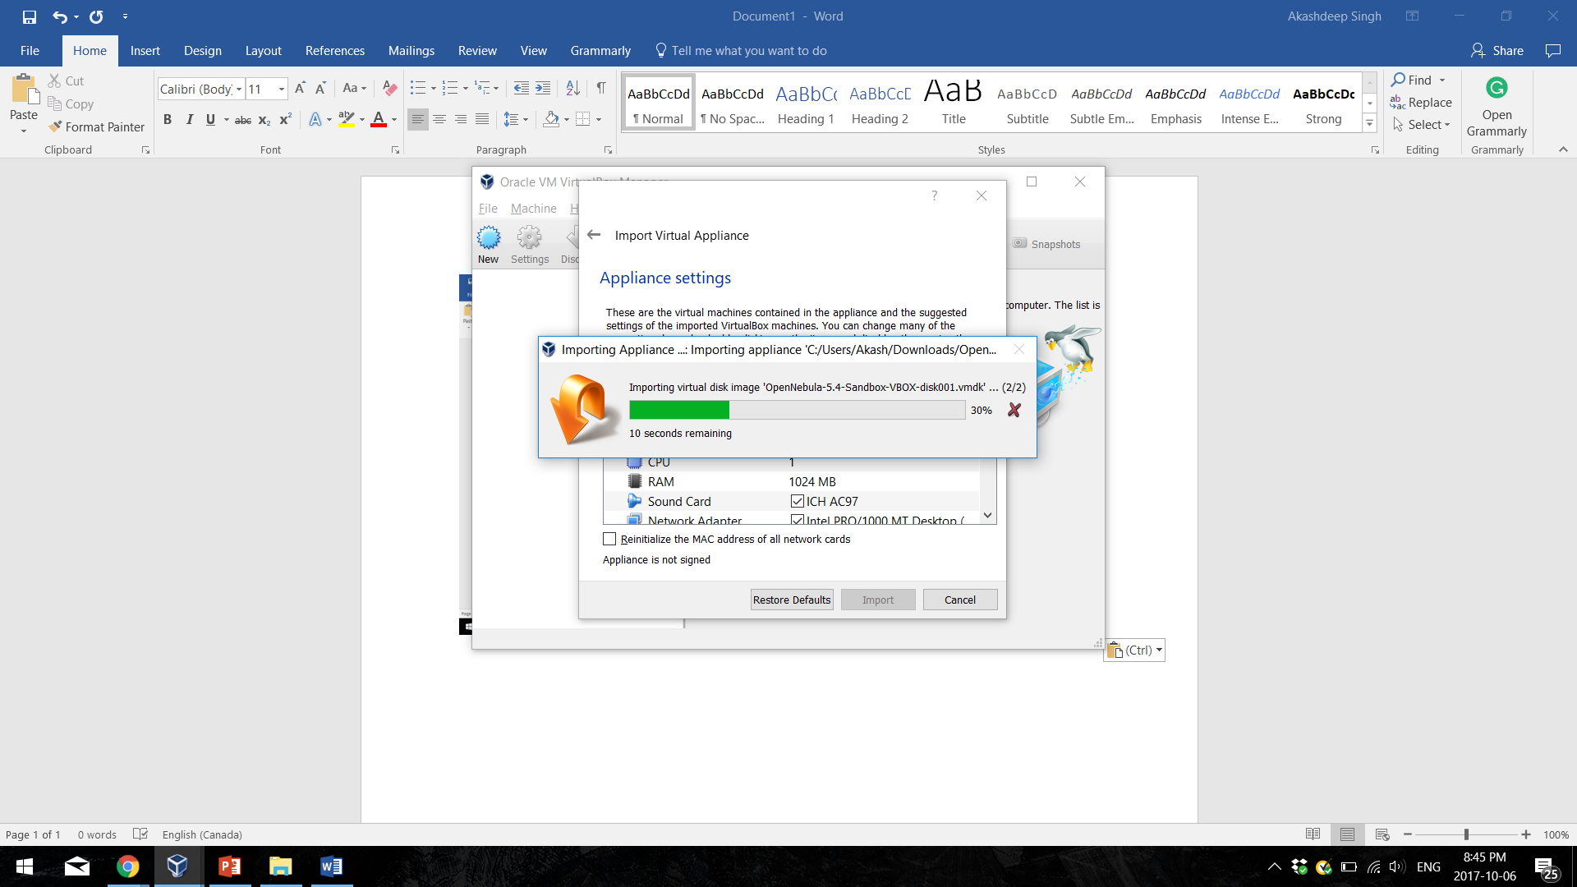

Slide 18
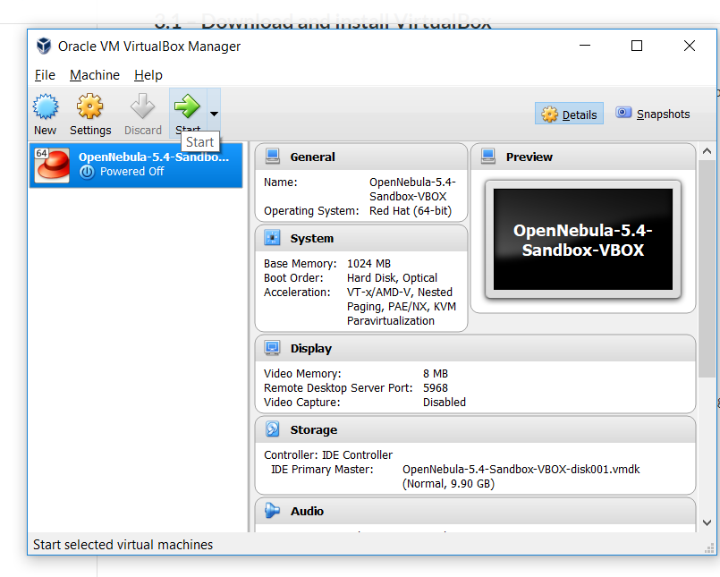

Slide 19
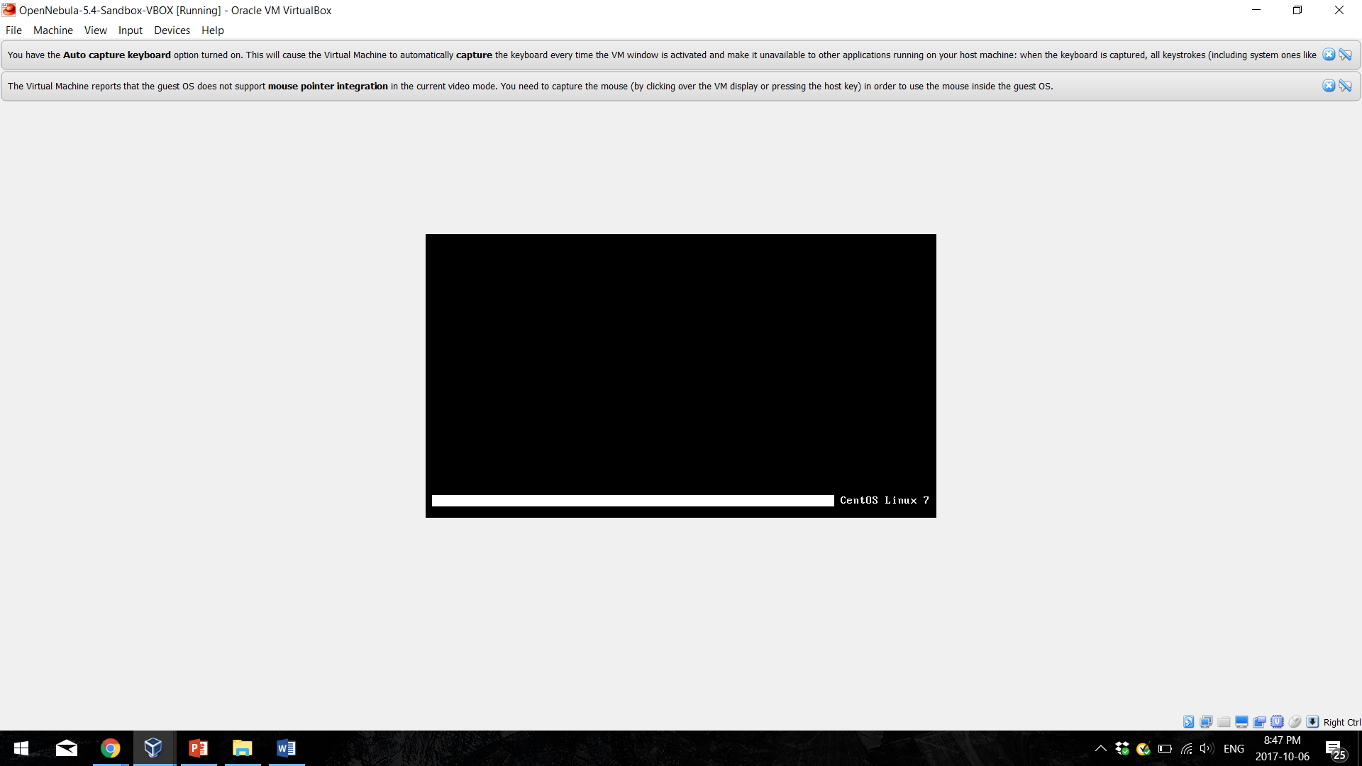

Slide 20
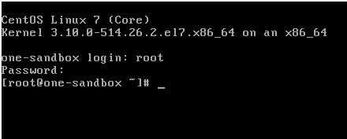

Slide 21
Rest is on browser
http://localhost:9869/
Username: OneAdmin
Password: OpenNebula

